Slide 1
ECON 3510 International Trade Theory and Policy
Internal Economies of Scale
Tutorial 8
Notes:
If this PowerPoint presentation contains mathematical equations, you may need to check that your computer has the following installed:
1) MathType Plugin
2) Math Player (free versions available)
3) NVDA Reader (free versions available)

Slide 2
Recap of Lecture 8
More production at the firm level causes average cost to fall.
With monopolistic competition:
product differentiation, free entry leads to zero economic profit
gains from trade: lower costs and prices, wider consumer choice
intra-industry trade
Dumping may be a legitimate profitable strategy
Multinationals larger and more productive than exporters, which are larger and more efficient than firms only selling domestically
Horizontal FDI when proximity to customers is more important than concentrating production in one location

Slide 3
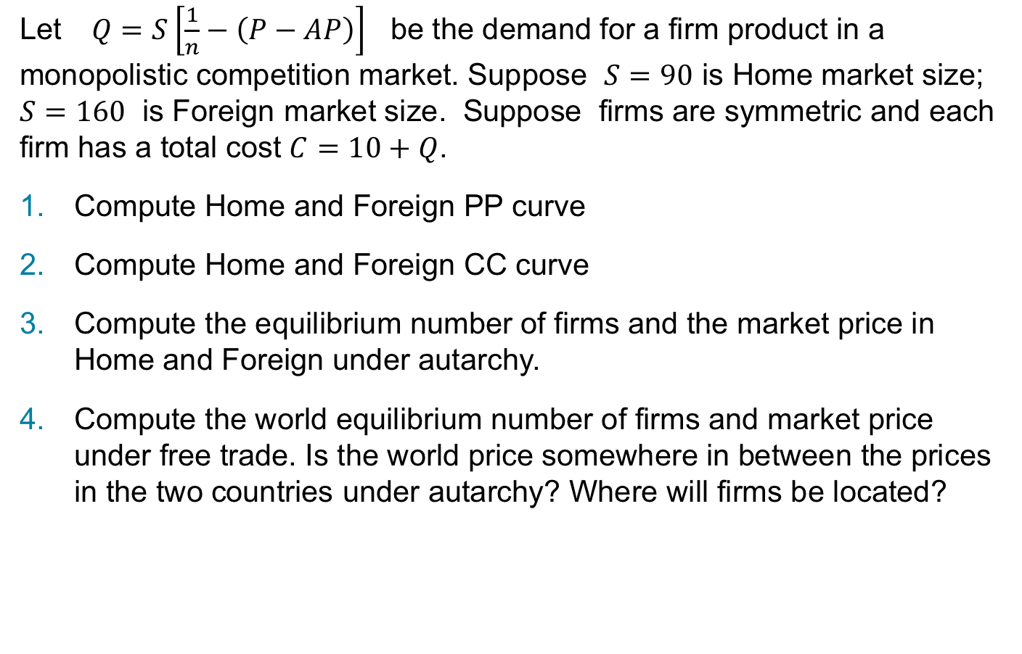
Exercise 1
Let $Q=S\left[\frac{1}{n}−\left(P−AP\right)\right]$ be the demand for a firm product in a monopolistic competition market. Suppose $S=90$ is Home market size; $S=160$ is Foreign market size. Suppose firms are symmetric and each firm has a total cost $C=10+Q$.
Compute Home and Foreign PP curve
Compute Home and Foreign CC curve
Compute the equilibrium number of firms and the market price in Home and Foreign under autarchy.
Compute the world equilibrium number of firms and market price under free trade. Is the world price somewhere in between the prices in the two countries under autarchy? Where will firms be located?
Notes:
Q = S [\frac{1}{n} - (P - AP)] \\
\frac{Q}{S} = \frac{1}{n} - P + AP \\
P = \frac{1}{n} + AP - \frac{Q}{S} \\
PQ = \frac{Q}{n} + AP \cdot Q + \frac{Q^{2}}{S} \\
\therefore MR = \frac{\partial }{ \partial Q} = \frac{1}{n} + AP - \frac{2Q}{S} \\
AP = \frac{Q}{S} - \frac{1}{n} + P \\
MR = \frac{1}{n} + \frac{Q}{S} - \frac{1}{n} + P - \frac{2Q}{S} \\
MR = P - \frac{Q}{S} \\
\text{equal market share implies: } Q = \frac{S}{n} \\
\therefore MR = P - \frac{1}{n} \\
MC = \frac{\partial}{\partial Q} = 1 \\
\text{So to solve for PP we have:} \\
MR = MC \\
P - \frac{1}{n} = 1 \\
P = 1 + \frac{1}{n} \ \ \ (PP) \\
AC = \frac{10}{Q} + 1 \\
\text{equal market share: } Q = \frac{S}{n} \\
\therefore AC = \frac{10n}{s} + 1 \\
P = \frac{10n}{s} + 1 \\
\text{For home:} \\
P = \frac{10n}{90} + 1 = \frac{n}{9} + 1 \ \ (CC home) \\
\text{For foreign:} \\
P = \frac{10n}{160} + 1 = \frac{n}{16} + 1 \ \ (CC foreign)
\text{Home:} \\
PP = CC \\
1 + \frac{1}{n} = \frac{n}{9} + 1 \\
\frac{1}{n} = \frac{n}{9} \\
9 = n^{2} \\
n = 3 \\
P = \frac{3}{9} + 1 = 1.333 \\
\text{Foreign:} \\
PP = CC \\
1 + \frac{1}{n} = \frac{n}{16} + 1 \\
18 = n^{2} \\
n = 4 \\
P = \frac{4}{16} + 1 = 1.25
s = 90 + 160 = 250 \\
CC = \frac{n}{25} + 1 \\
PP = CC \\
1 + \frac{1}{n} = \frac{n}{25} + 1 \\
n^{2} = 25 \\
n = 5

Slide 4
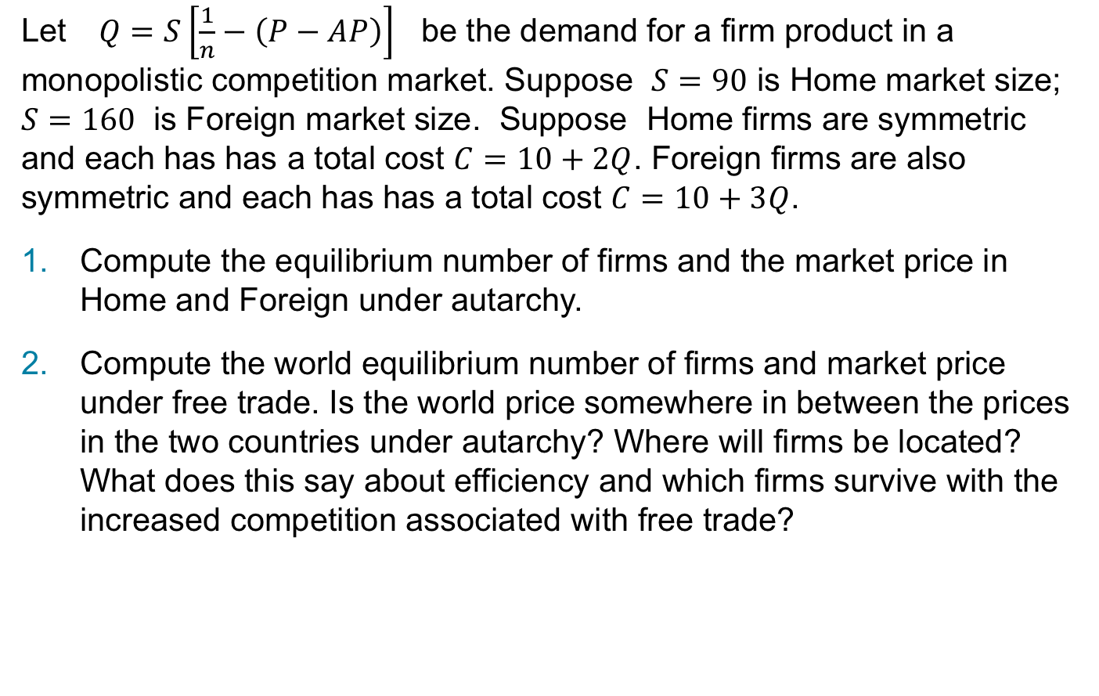
Exercise 2
Let $Q=S\left[\frac{1}{n}−\left(P−AP\right)\right]$ be the demand for a firm product in a monopolistic competition market. Suppose $S=90$ is Home market size; $S=160$ is Foreign market size. Suppose Home firms are symmetric and each has has a total cost $C=10+2Q$. Foreign firms are also symmetric and each has has a total cost $C=10+3Q$.
Compute the equilibrium number of firms and the market price in Home and Foreign under autarchy.
Compute the world equilibrium number of firms and market price under free trade. Is the world price somewhere in between the prices in the two countries under autarchy? Where will firms be located? What does this say about efficiency and which firms survive with the increased competition associated with free trade?
Notes:
\text{As before we have that for both home and foreign}: \\
MR = P - \frac{1}{n} \\
\text{MC in home is } \frac{\partial}{ \partial Q} = 2 \text{ so PP is}: \\
MR = MC \\
P - \frac{1}{n} = 2 \\
\therefore P = 2 + \frac{1}{n} \ \ (PP) \\
\text{AC in home is:} \\
AC = \frac{10}{Q} + 2 \\
AC = \frac{10n}{s} + 2 \\
\text{Therefpre CC in home}: \\
CC = \frac{10n}{s} + 2 \\
CC = \frac{10n}{90} + 2 \\
CC = \frac{n}{9} + 2 \ \ (CC) \\
\text{So we have:} \\
CC = PP \\
\frac{n}{9} + 2 = 2 + \frac{1}{n} \\
n^{2} = 9 \\
n = 3 \\
P = 2.333
\text{As before we have that for both home and foreign}: \\
MR = P - \frac{1}{n} \\
\text{MC in foreign is } \frac{\partial}{\partial Q} = 3: \\
P = 3 + \frac{1}{n} \\
\text{AC for foreign is}: \\
AC = \frac{10}{Q} + 3 \\
AC = \frac{10n}{s} + 3 \\
\text{Therefore CC in foreign is:} \\
CC = \frac{10n}{s} + 3 \\
CC = \frac{10n}{160} + 3 \\
CC = \frac{n}{16} + 3 \\
\text{So we have:} \\
CC = PP \\
\frac{n}{16} + 3 = 3 + \frac{1}{n} \\
n^{2} = 16 \\
n = 4 \\
p = 3.25
s = 90 + 160 = 250 \\
\text{If home takes over production then CC is}: \\
CC = \frac{n}{25} + 2 \\
PP = CC \\
2 + \frac{1}{n} = \frac{n}{25} + 2 \\
n^{2} = 25 \\
n = 5 \\
P = 2.2 \\
\text{If foreign takes over production then CC is:} \\
CC = \frac{n}{25} + 3 \\
PP = CC \\
\frac{1}{n} + 3 = \frac{n}{25} + 3 \\
n = 5 \\
P = 3.2 \\
\text{Since } P^{*} > P \text{ we would expect that all production will be located in home - reflecting its lower marginal cost}

Slide 5
Exercise 3
Australia anti-dumping policy. Is it protectionism in disguise?
https://www.afr.com/politics/federal/australia-suffers-embarassing-wto-defeat-20191211-p53iz3
https://mailchi.mp/huntvic/hunt-hunt-ttp-4683977?e=0c6f3dd246

